Slide 1
Object Detection

Slide 2
Overview
Intro
Part I: Two Stage Detection
Part II: Unified Detection
Part III: Others
Summary and comparison

Slide 3
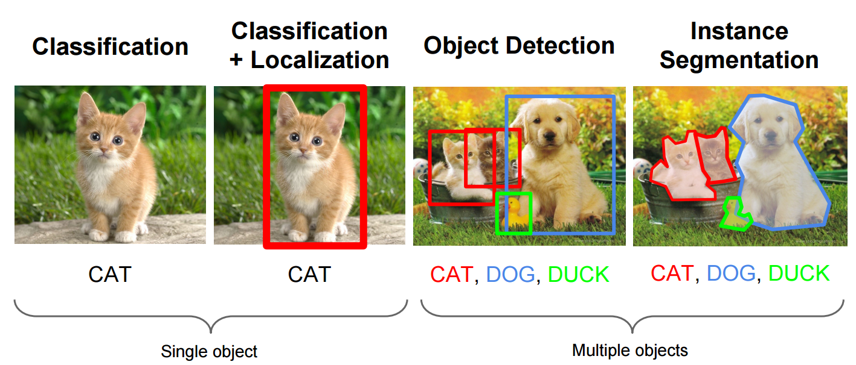
What is object detection
http://cs231n.stanford.edu/slides/winter1516_lecture8.pdf

Slide 4
What are the challenges of object detection?
Images may contain more than one class, multiple instances from the same class
Bounding box localization
Evaluation
Image source

Slide 5
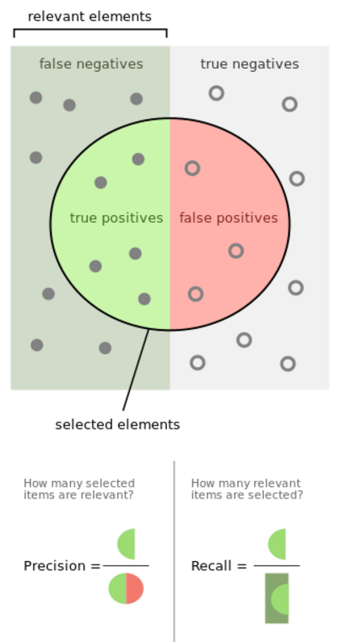

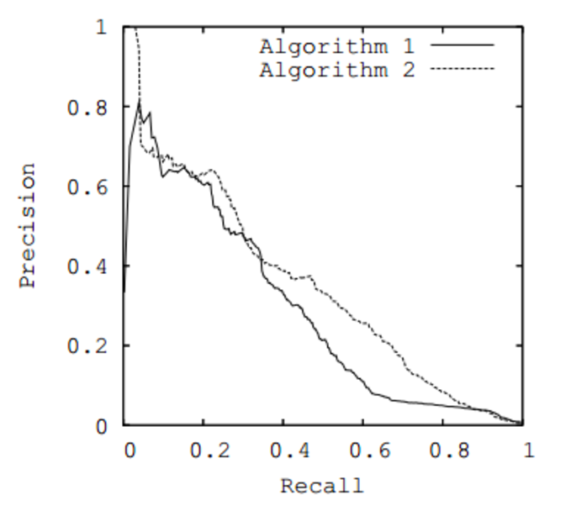
Terms
Recall
Precision
mAP
IoU
https://en.wikipedia.org/wiki/Precision_and_recall
Notes:
Add recall precision curve

Slide 6
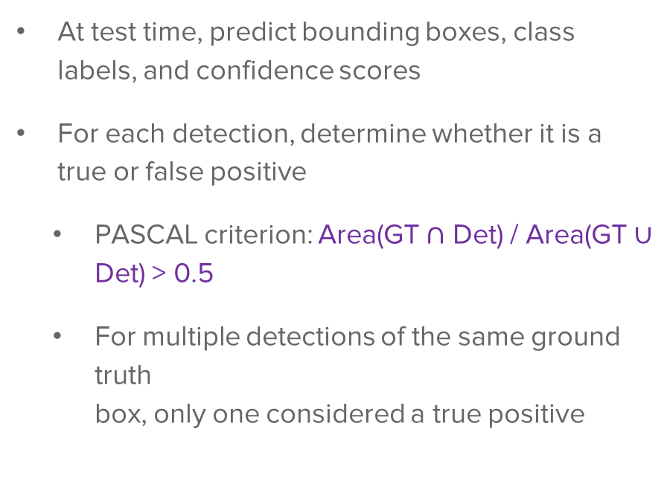
Object detection evaluation
At test time, predict bounding boxes, class labels, and confidence scores
For each detection, determine whether it is a true or false positive
PASCAL criterion: Area(GT $∩$ Det) / Area(GT $∪$ Det) > 0.5
For multiple detections of the same ground truth box, only one considered a true positive
Ground truth (GT)
dog: 0.6
dog
dog: 0.55
cat: 0.8
cat

Slide 7
Object detection evaluation
At test time, predict bounding boxes, class labels, and confidence scores
For each detection, determine whether it is a true or false positive
For each class, plot Recall-Precision curve and compute Average Precision (area under the curve)
Take mean of AP over classes to get mAP
Precision:
true positive detections / total detections
Recall:
true positive detections / total positive test instances

Slide 8
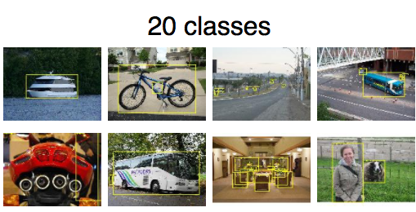
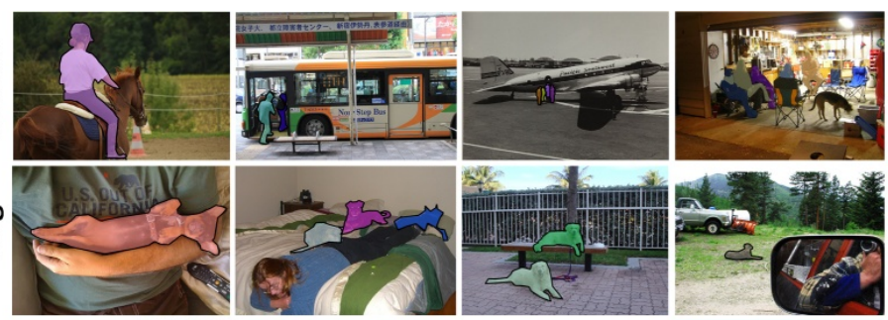
Detection Competitions
VOC: 20 classes
Pascal VOC
COCO
ImageNet ILSVRC
COCO: 200 classes
http://host.robots.ox.ac.uk/pascal/VOC/voc2012/index.html#introduction
Notes:
How many classes? Sample images

Slide 9
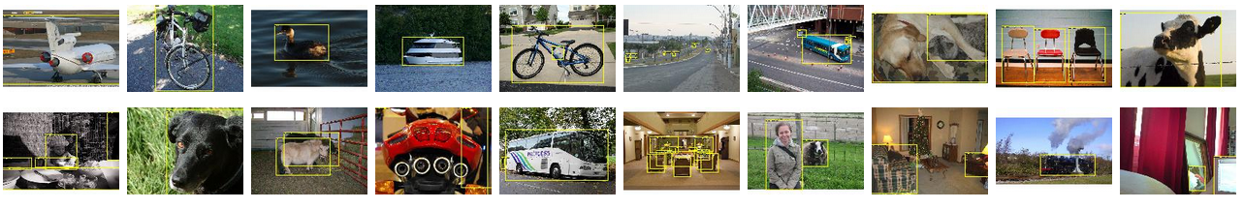
PASCAL VOC Challenge (2005-2012)
20 challenge classes:
Person
Animals: bird, cat, cow, dog, horse, sheep
Vehicles: aeroplane, bicycle, boat, bus, car, motorbike, train
Indoor: bottle, chair, dining table, potted plant, sofa, tv/monitor
Dataset size (by 2012): 11.5K training/validation images, 27K bounding boxes, 7K segmentations
http://host.robots.ox.ac.uk/pascal/VOC/

Slide 10
Progress on PASCAL detection
PASCAL VOC
Before CNNs

Slide 11
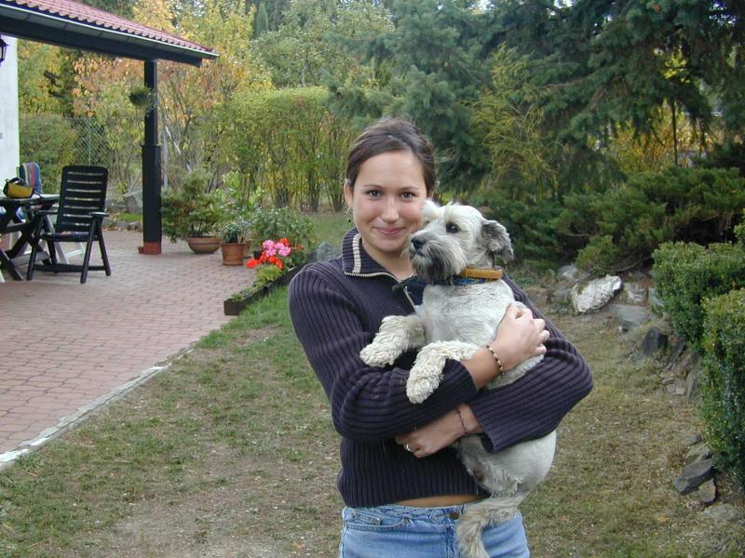
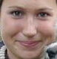
Conceptual approach: Sliding window detection
Detection
Slide a window across the image and evaluate a detection model at each location
Thousands of windows to evaluate: efficiency and low false positive rates are essential
Difficult to extend to a large range of scales, aspect ratios

Slide 12
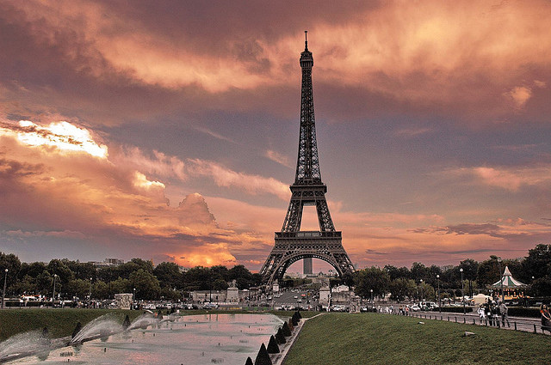
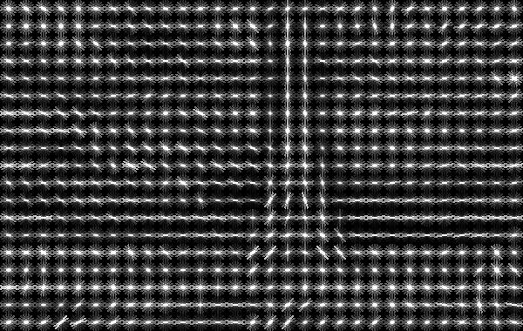
Histograms of oriented gradients (HOG)
Partition image into blocks and compute histogram of gradient orientations in each block
Image credit: N. Snavely
N. Dalal and B. Triggs, Histograms of Oriented Gradients for Human Detection, CVPR 2005

Slide 13
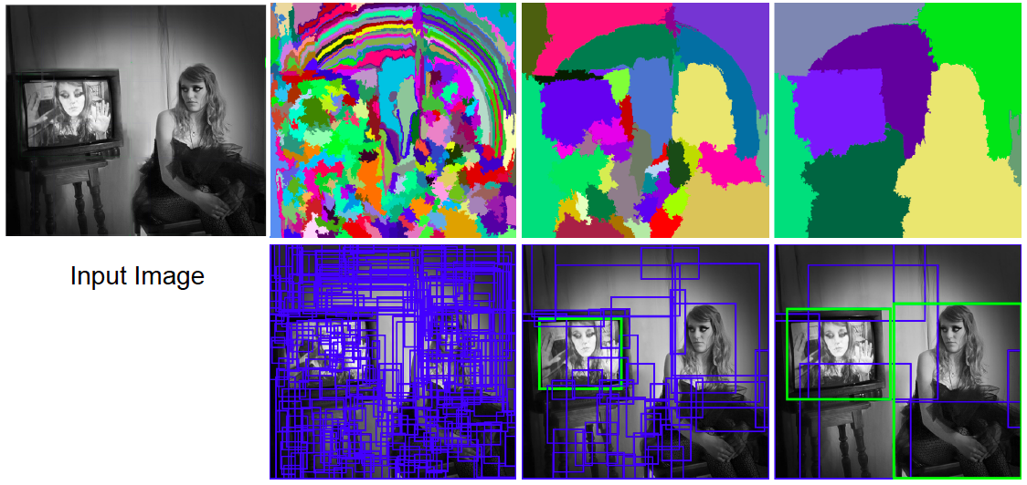
Selective search for detection
Use hierarchical segmentation: start with small superpixels and merge based on diverse cues
J. Uijlings, K. van de Sande, T. Gevers, and A. Smeulders, Selective Search for Object Recognition, IJCV 2013

Slide 14
Hard Negative Mining
Non Maximum Suppression
Imbalance between positive and negative examples.
Use negative examples with higher confidence score.
If output boxes overlap, only consider the most confident.
Notes:
Mention in beginning. Used in all.

Slide 15
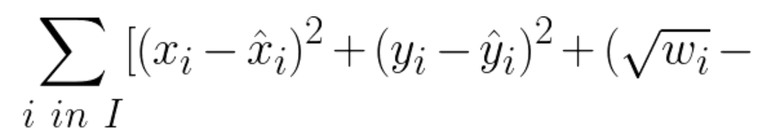
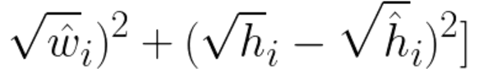
Bounding Box Regression
Regression used to find bounding box parameters
Applied in one of two ways
Bounding box refinement
Complete object detection
Example Loss Function
I is the set of all matching bounding boxes (Highest IoU with ground truth)

Slide 16
Two Stage Detection
Part I

Slide 17
RCNN : Region Proposal + CNN
Use selective search to come up with regional proposal
First object detection method using CNN
Rich feature hierarchies for accurate object detection and semantic segmentation
Ross Girshick Jeff Donahue Trevor Darrell Jitendra Malik
Nov 2013
https://people.eecs.berkeley.edu/~rbg/papers/r-cnn-cvpr.pdf

Slide 18
R-CNN: Region proposals + CNN features
SVMs
Classify regions with SVMs
SVMs
ConvNet
SVMs
ConvNet
Forward each region through ConvNet
ConvNet
Warped image regions
Region proposals
Input image
R. Girshick, J. Donahue, T. Darrell, and J. Malik, Rich Feature Hierarchies for Accurate Object Detection and Semantic Segmentation, CVPR 2014.
Notes:
The features are also sent to a linear regressor that improves object localization.
The components outlined in purple are “post hoc” in the sense that they are learned after the convnet weights are trained and forever frozen.

Slide 19
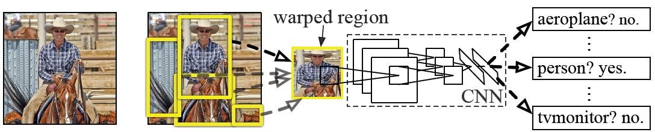
R-CNN details
Regions: ~2000 Selective Search proposals
Network: AlexNet pre-trained on ImageNet (1000 classes), fine-tuned on PASCAL (21 classes)
Final detector: warp proposal regions, extract fc7 network activations (4096 dimensions), classify with linear SVM
Bounding box regression to refine box locations
Performance: mAP of 53.7% on PASCAL 2010 (vs. 35.1% for Selective Search and 33.4% for Deformable Part Models)
Notes:
Object detection system overview. Our system (1) takes an input image, (2) extracts around 2000 bottom-up region proposals, (3) computes features for each proposal using a large convolutional neural network (CNN), and then (4) classifies each region using class-specific linear SVMs. R-CNN achieves a mean average precision (mAP) of 53.7% on PASCAL VOC 2010. For comparison, Uijlings et al. (2013) report 35.1% mAP using the same region proposals, but with a spatial pyramid and bag-of-visual-words approach. The popular deformable part models perform at 33.4%.

Slide 20
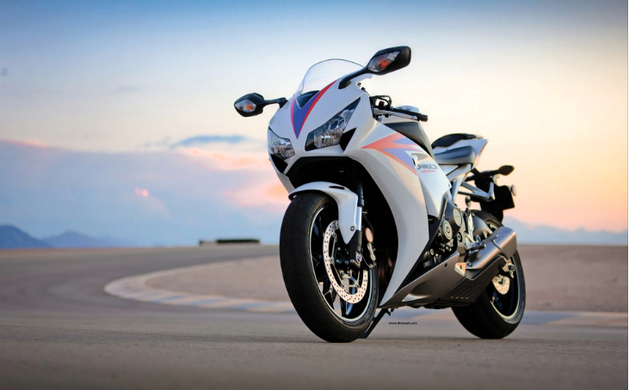
Training RCNN
Step1: train your own CNN model for classification ( or use existing model), using ImageNet dataset.
Fully connected layer
Convolution and Pooling
Softmax loss
1000 classes scores
4096 * 1000
Image source : http://www.shunvmall.com/bike-pic/47539009.html

Slide 21
Training RCNN
Step2: focus on 20 classes + 1 background. Remove the last FC layer and replace it with a smaller layer and fine-tune the model using PASCAL VOC dataset
Fully connected layer
Convolution and Pooling
Softmax loss
21 classes scores
4096 * 21

Slide 22
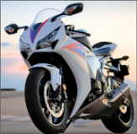

Training RCNN
Step3: extract feature
Crop & Warp
Image
Convolution and Pooling
Store all the features after pool 5 layer and save to disk
It is about ~ 200G features
Proposals

Slide 23
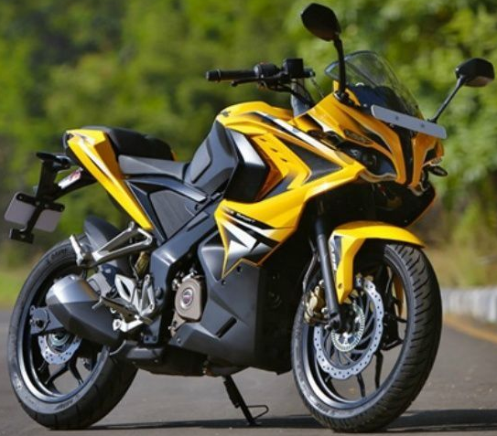


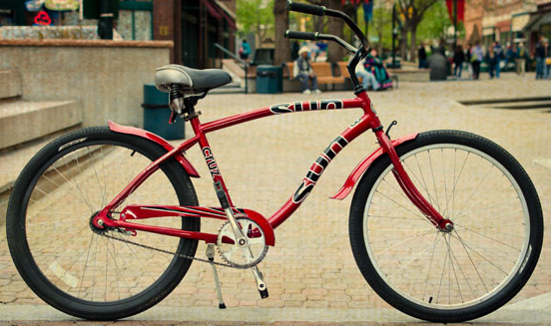
Training RCNN
Step4: train SVM for each class
Crop / Warp image
Features from last step
Positive samples for Motorbike
Negative samples for Motorbike

Slide 24
Training RCNN
Step4: train SVM for each class
Crop / Warp image
Features from last step
Negative samples for Bicycle
Positive samples for Bicycle

Slide 25
R-CNN pros and cons
Pros
Accurate!
Any deep architecture can immediately be “plugged in”
Cons
Not a single end-to-end system
Fine-tune network with softmax classifier (log loss)
Train post-hoc linear SVMs (hinge loss)
Train post-hoc bounding-box regressions (least squares)
Training is slow (84h), takes a lot of disk space
2000 CNN passes per image
Inference (detection) is slow (47s / image with VGG16)

Slide 26
Fast R-CNN
Softmax classifier
Linear +
softmax
Linear
Bounding-box regressors
FCs
Fully-connected layers
RoI Pooling layer
Region proposals
Conv5 feature map of image
ConvNet
Forward whole image through ConvNet
Source: R. Girshick
R. Girshick, Fast R-CNN, ICCV 2015
Notes:
Rather than using post-hoc bounding-box regressors, bounding-box regression is implemented as an additional linear layer in the network

Slide 27
Fast RCNN
Share convolution layers for proposals from the same image
Faster and More accurate than RCNN
ROI Pooling
Fast R-CNN
Ross Girshick
Apr 2015
https://arxiv.org/pdf/1504.08083v2.pdf
Notes:
Google roi pooling ppt ross girshic differentiable roi

Slide 28
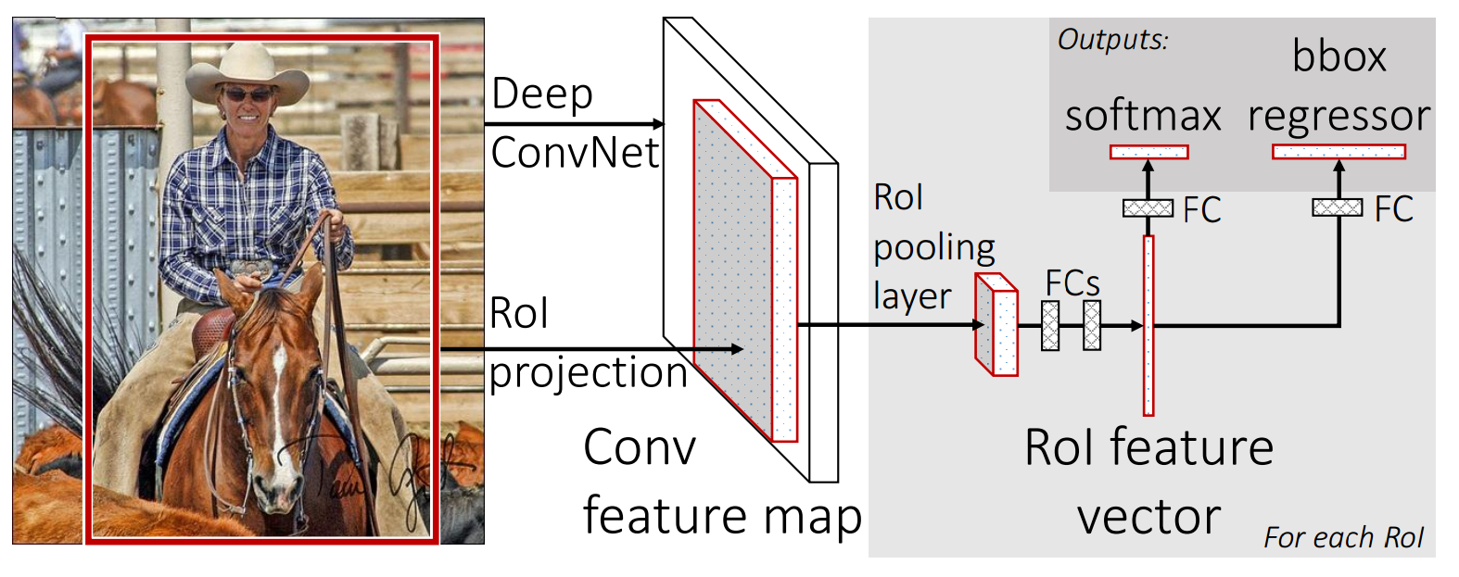
Fast RCNN
https://arxiv.org/pdf/1504.08083v2.pdf
Notes:
Google roi pooling ppt ross girshic differentiable roi

Slide 29
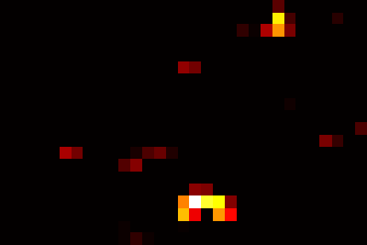
RoI pooling
“Crop and resample” a fixed-size feature representing a region of interest out of the outputs of the last conv layer
Use nearest-neighbor interpolation of coordinates, max pooling
Conv feature map
RoI pooling layer
FC layers …
Region of Interest (RoI)
RoI feature
Source: R. Girshick, K. He

Slide 30
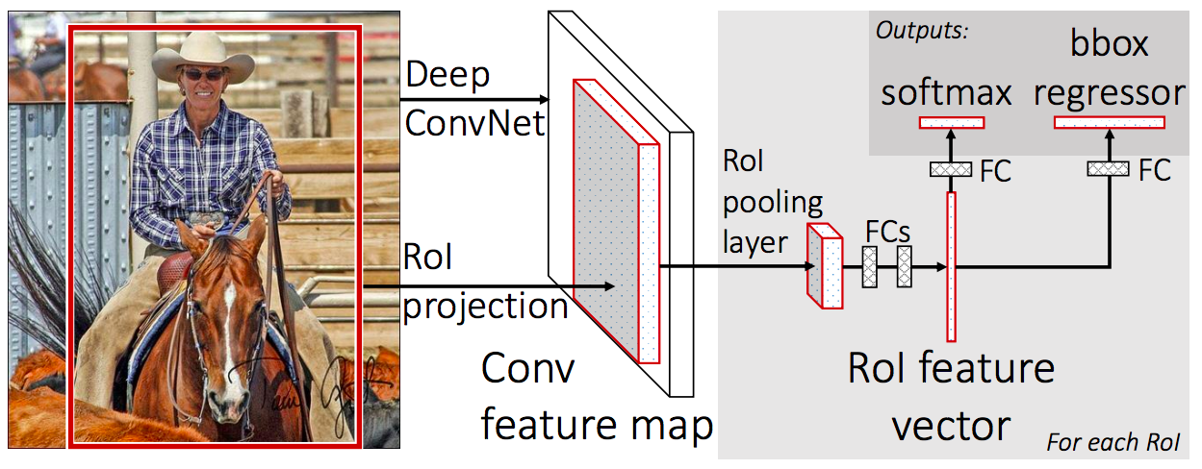
Prediction
For each RoI, network predicts probabilities for C+1 classes (class 0 is background) and four bounding box offsets for C classes
R. Girshick, Fast R-CNN, ICCV 2015

Slide 31
What is bbox-regressor?
Bounding box regression
Fully connected layer
Convolution and Pooling
Softmax loss
Total loss
Overfeat, VGG
DeepPose, R-CNN
4 value
(x,y,w,h)
L2 loss
OR
L1 loss

Slide 32
Fully connected layer
Convolution and Pooling
Softmax loss
Total loss
4 value
(x,y,w,h)
Smooth
L1 loss
Notes:
Show equation

Slide 33
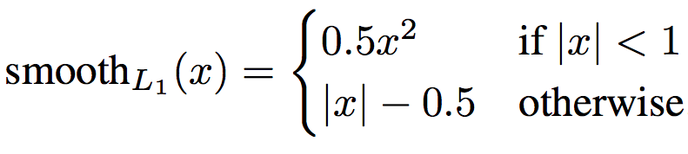
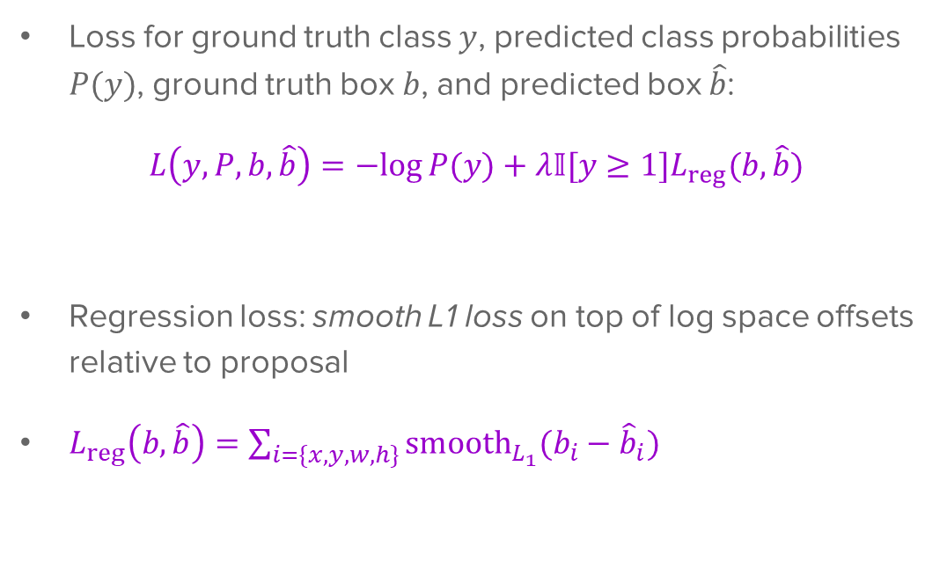
Multi-task loss
Loss for ground truth class $y$, predicted class probabilities $P(y)$, ground truth box $b$, and predicted box $\hat{b}$:
$$L\left(y, P, b,\hat{b}\right)=−log⁡P(y)+λ𝕀[y≥1]L_{reg}(b,\hat{b})$$
Regression loss: smooth L1 loss on top of log space offsets relative to proposal
$L_{reg}\left(b,\hat{b}\right)=\sum_{i=\{x,y,w,h\}}{{smooth}_{L_{1}}(b_{i}−{\hat{b}}_{i}})$
softmax loss
regression loss

Slide 34
Bounding box regression
Ground truth box
Target offset to predict*
Region proposal
(a.k.a default box, prior, reference, anchor)
Loss
Predicted offset
Predicted box
*Typically in transformed, normalized coordinates

Slide 35
Result compare
Trained using VGG 16 on Pascal VOC 2007 dataset
Not including proposal time
Source: R. Girshick
 | Fast R-CNN | R-CNN
Train time (h) | 9.5 | 84
-speedup | 8.8x | 1x
Test time/image | 0.32s | 47.00 s
-test speedup | 146x | 1x
mAP | 66.9 | 66

Slide 36
Result compare
Source: cs231 standford
 | Fast R-CNN | R-CNN
Test time/image | 0.32s | 47.00 s
-test speedup | 146x | 1x
Test time/image with proposal | 2s | 50 s
-test speedup | 25x | 1x

Slide 37
Faster RCNN
Don’t need to have external regional proposals
RPN - Regional Proposal Network
Faster R-CNN: Towards Real-Time Object Detection with Region Proposal Networks
Shaoqing Ren, Kaiming He, Ross Girshick, and Jian Sun
Jun 2015
https://arxiv.org/pdf/1506.01497v3.pdf

Slide 38
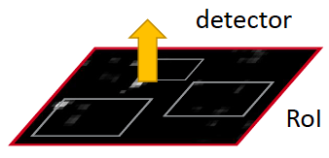
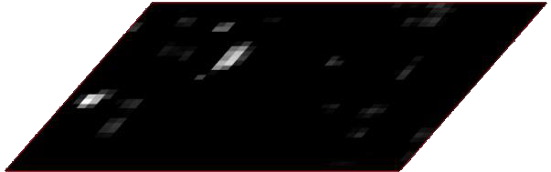
Faster R-CNN
Region proposals
Region Proposal Network
feature map
feature map
CNN
CNN
share features
S. Ren, K. He, R. Girshick, and J. Sun, Faster R-CNN: Towards Real-Time Object Detection with Region Proposal Networks, NIPS 2015

Slide 39
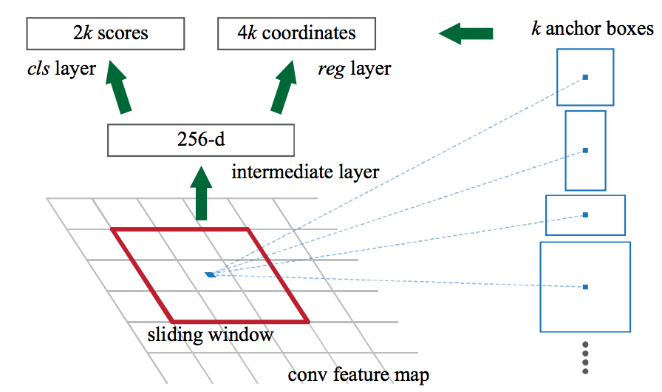
Region proposal network (RPN)
Slide a small window (3x3) over the conv5 layer
Predict object/no object
Regress bounding box coordinates with reference to anchors (3 scales x 3 aspect ratios)
Notes:
At each sliding-window location, we simultaneously predict multiple region proposals, where the number of maximum possible proposals for each location is denoted as k. So the reg layer has 4k outputs encoding the coordinates of k boxes, and the cls layer outputs 2k scores that estimate probability of object or not object for each proposal

Slide 40

One network, four losses
Classification loss
Bounding-box regression loss
…
Classification loss
Bounding-box regression loss
RoI pooling
proposals
Region Proposal Network
feature map
CNN
Source: R. Girshick, K. He
image

Slide 41
Result compare
Trained using Pascal VOC 2007 dataset
Source: cs231 standford
 | Faster R-CNN | Fast R-CNN | R-CNN
Test time/image With proposal | 0.2S | 2s | 50s
-test speedup | 250x | 25x | 1x
mAP | 66.9 | 66.9 | 66

Slide 42
Object detection progress
Faster R-CNN
Fast R-CNN
Before CNNs
R-CNNv1
After CNNs

Slide 43
Unified Detection
Part II

Slide 44
Problems with 2 step detection.
Complex Pipeline
Slow (Cannot run in real time)
Hard to optimize each component

Slide 45
Streamlined detection architectures
The Faster R-CNN pipeline separates proposal generation and region classification:
Is it possible do detection in one shot?
Region Proposals
RPN
Classification + Regression
Conv feature map of the entire image
RoI features
Detections
RoI pooling
Classification + Regression
Conv feature map of the entire image
Detections

Slide 46
Yolo: You Only Look Once
Consider detection as a regression problem
Use a single ConvNet
Runs once on entire image. Very Fast!
You only look once: Unified, real-time object detection.
Joseph Redmon, Santosh Divvala, Ross Girshick, Ali Farhadi
June 2015
Notes:
Full citation of paper

Slide 47
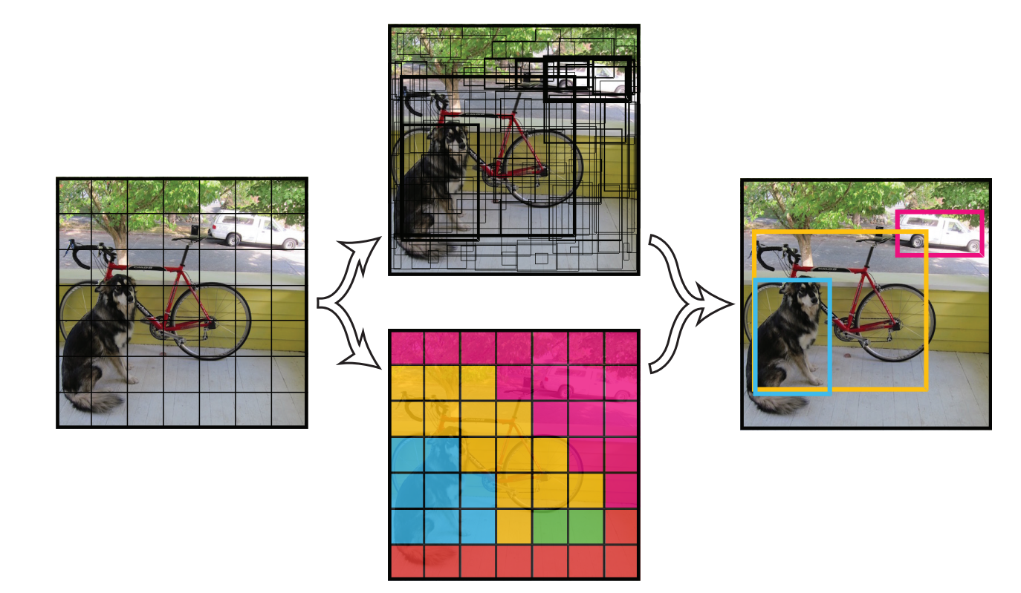
How it works
The following predictions are made for each cell in an S x S grid.
C conditional class probabilities Pr(Class_{i} | Obj)
B bounding boxes (4 parameters each)
B confidence scores Pr(Obj)*IoU
Output is S x S x (5B+C) tensor
https://arxiv.org/pdf/1506.02640v5.pdf

Slide 48
YOLO
Take conv feature maps at 7x7 resolution
Add two FC layers to predict, at each location, a score for each class and 2 bboxes w/ confidences
For PASCAL, output is 7x7x30 (30 = 20 + 2*(4+1))
J. Redmon, S. Divvala, R. Girshick, and A. Farhadi, You Only Look Once: Unified, Real-Time Object Detection, CVPR 2016

Slide 49
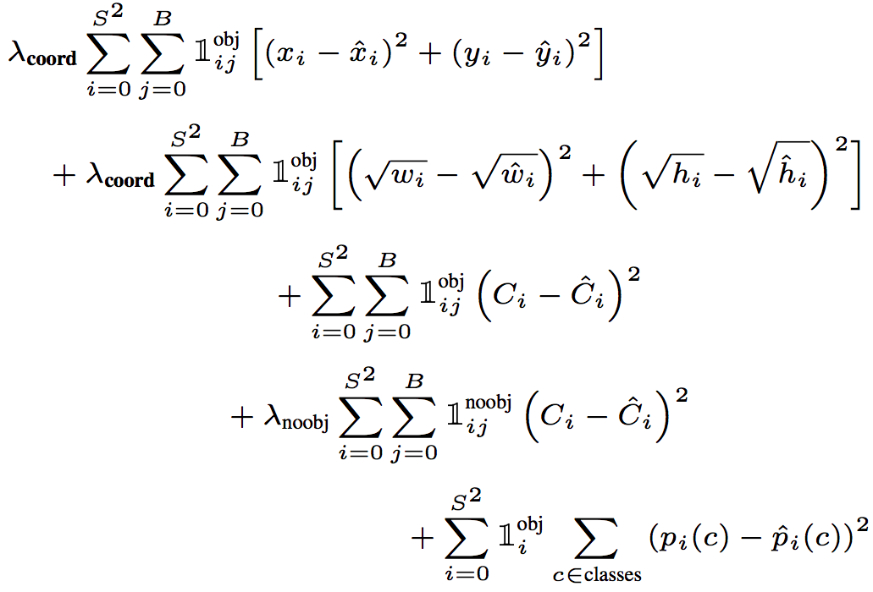
YOLO
Objective function:
Regression
Object/no object confidence
Class prediction
Notes:
At training time we only want one bounding box predictor to be responsible for each object. We assign one predictor to be “responsible” for predicting an object based on which prediction has the highest current IOU with the ground truth.

Slide 50
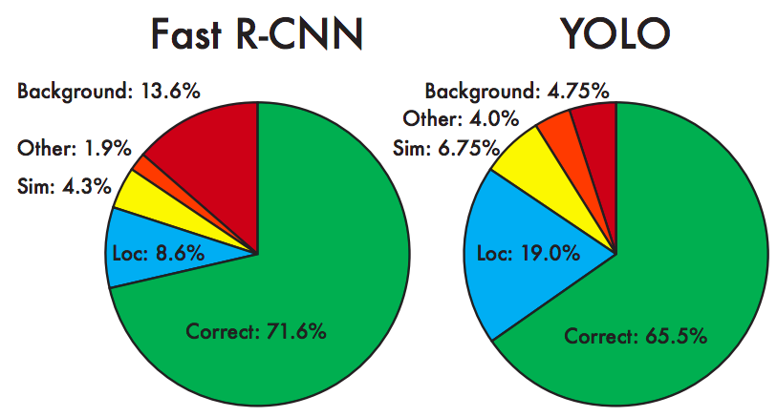
YOLO: Results
Each grid cell predicts only two boxes and can only have one class – this limits the number of nearby objects that can be predicted
Localization accuracy suffers compared to Fast(er) R-CNN due to coarser features, errors on small boxes
7x speedup over Faster R-CNN (45-155 FPS vs. 7-18 FPS)
Performance on PASCAL 2007

Slide 51
Performance (VOC 2007)
 | Yolo | Faster R-CNN (VGG-16)
mAP | 63.4 | 73.2
FPS | 45 | 7
Trained on Pascal VOC 2007 + 2012 dataset
https://arxiv.org/pdf/1506.02640v5.pdf
Notes:
Highlight important stuff
Or just use bullet points

Slide 52
Limitations of Yolo
Struggles with small objects
Struggles with unusual aspect ratios
Poor localization

Slide 53
SSD Single Shot Detector
Faster than Yolo, as accurate as Faster R-CNN
Predicts categories and box offsets
Uses small convolutional filters applied to feature maps
Makes predictions using feature maps of different scales
SSD: Single shot multibox detector
Wei Liu, Dragomir Anguelov, Dumitru Erhan, Christian Szegedy, Scott Reed, Cheng-Yang Fu, Alexander C. Berg
Dec 2015

Slide 54
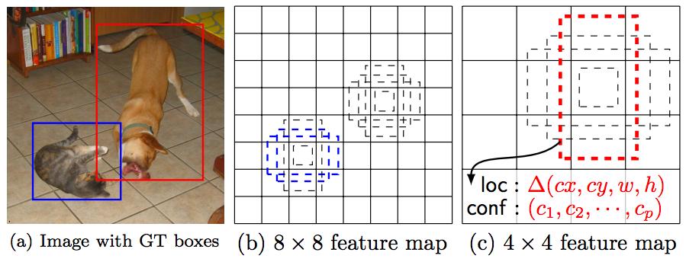
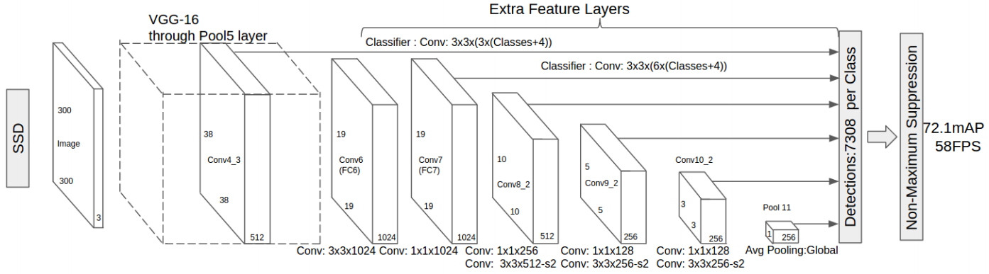
SSD
W. Liu, D. Anguelov, D. Erhan, C. Szegedy, S. Reed, C.-Y. Fu, and A. Berg, SSD: Single Shot MultiBox Detector, ECCV 2016.
Notes:
In a convolutional fashion, we evaluate a small set (e.g. 4) of default boxes of different aspect ratios at each location in several feature maps with different scales (e.g. 8 × 8 and 4 × 4 in (b) and (c)). For each default box, we predict both the shape offsets and the confidences for all object categories ((c1, c2, · · · , cp)). At training time, we first match these default boxes to the ground truth boxes. For example, we have matched two default boxes with the cat and one with the dog, which are treated as positives and the rest as negatives. The model loss is a weighted sum between localization loss (e.g. Smooth L1 [6]) and confidence loss (e.g. Softmax).

Slide 55
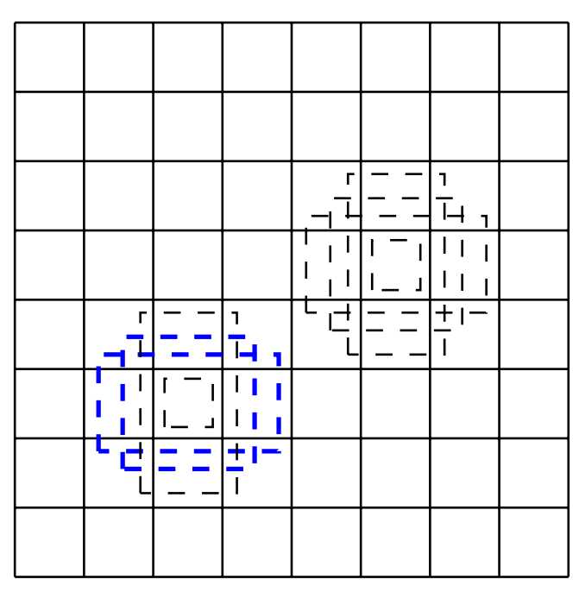
Default Boxes
Multiple aspect ratios per cell.
Similar to Faster R-CNN Anchor Boxes.
Applied to many feature maps.
https://arxiv.org/pdf/1512.02325v5.pdf

Slide 56
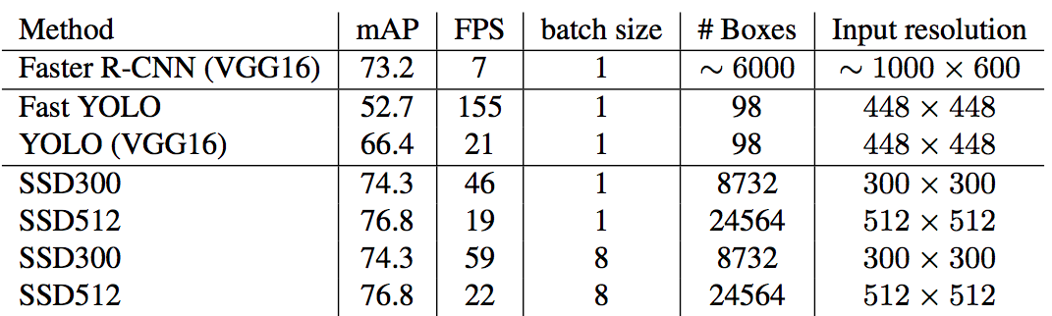
SSD: Results (PASCAL 2007)
More accurate and faster than YOLO and Faster R-CNN

Slide 57
SSD Detector
Detectors are convolutional filters.
Each detector outputs a single value.
Predict class probabilities.
Predict bounding box offsets.
(classes + 4) detectors are needed for a detection.
(classes + 4) x (#default boxes) x m x n outputs for a mxn feature map.

Slide 58
Results (VOC 2007)
 | SSD* | Yolo* | Faster R-CNN*
mAP | 74.3 | 66.4 | 73.2
FPS | 46 | 21 | 7
*VGG16
Trained on Pascal VOC 2007 + 2012 dataset
https://arxiv.org/pdf/1512.02325v5.pdf

Slide 59
Others
Part III

Slide 60
Feature Pyramid Networks
Uses ConvNet as Feature Pyramid
Includes low level feature maps to detect small objects
Top down pathway provides contextual information
Feature Pyramid Networks for Object Detection.
Tsung-Yi Lin, Piotr Dollár, Ross Girshick, Kaiming He, Bharath Hariharan, Serge Belongie.
Dec 2016

Slide 61
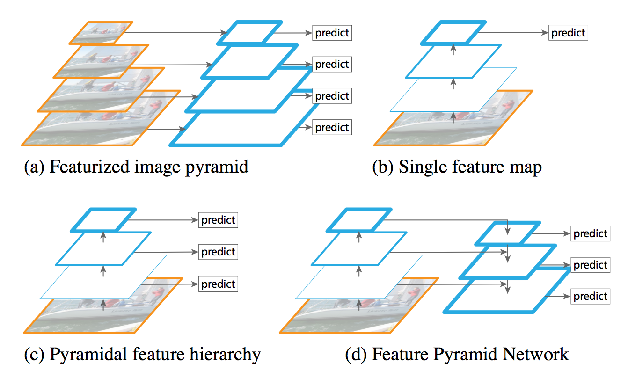
Comparison to prior methods
Accurate but slow.
Misses low level information. (Yolo)
Misses context in low level predictions. (SSD)
Accurate and fast.
https://arxiv.org/pdf/1512.02325v5.pdf

Slide 62
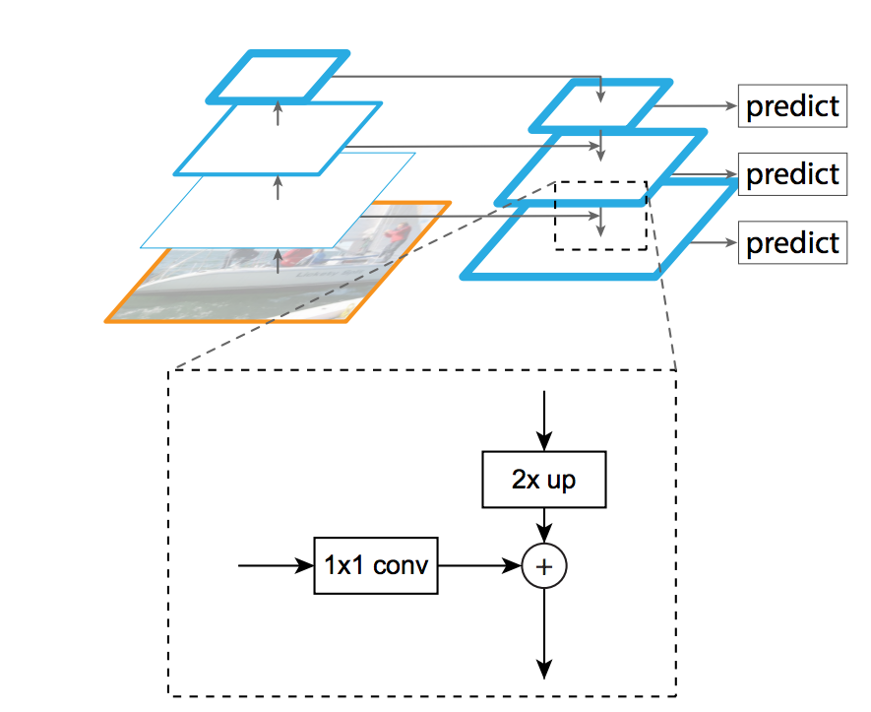
Top down pathway
High level (semantically strong) feature maps are upsampled.
Lateral connections merge feature maps from bottom up pathway.
https://arxiv.org/pdf/1512.02325v5.pdf

Slide 63
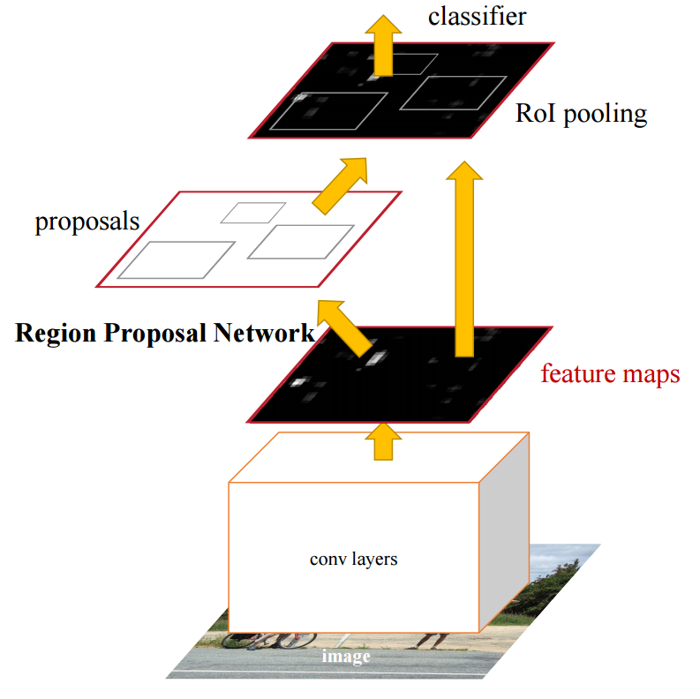
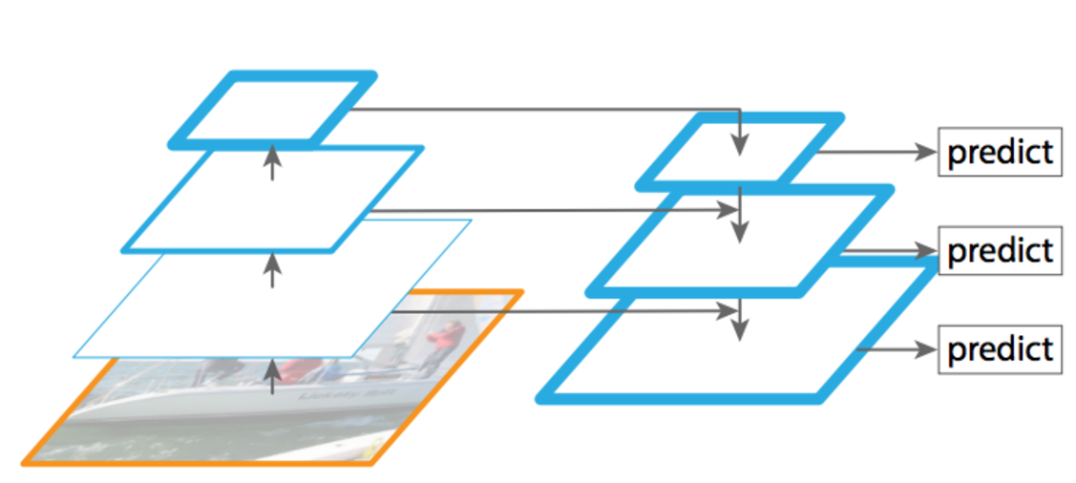
Feature Pyramid Networks for RPN
Replace single scale feature map with FPN.
Single scale anchors at each level.
https://arxiv.org/pdf/1512.02325v5.pdf

Slide 64
Results
COCO
State of the art single-model
 | Faster R-CNN on FPN* | Faster R-CNN +++* | ION**
mAP | 36.2 | 34.9 | 31.2
mAP (small images) | 18.2 | 15.6 | 12.8
* ResNet-101
** VGG-16
https://arxiv.org/pdf/1512.02325v5.pdf

Slide 65
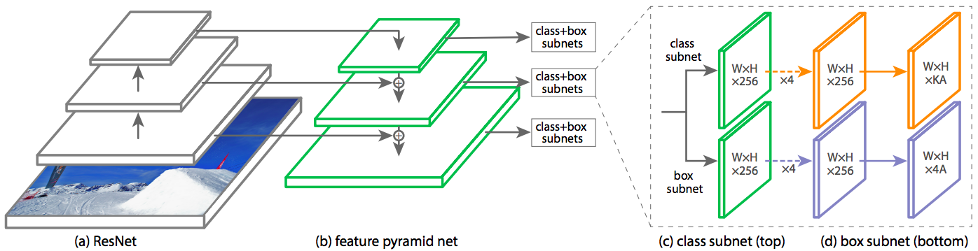
RetinaNet
Combine feature pyramid network with focal loss to reduce the standard cross-entropy loss for well-classified examples
T.-Y. Lin, P. Goyal, R. Girshick, K. He, P. Dollar, Focal loss for dense object detection,
ICCV 2017.

Slide 66
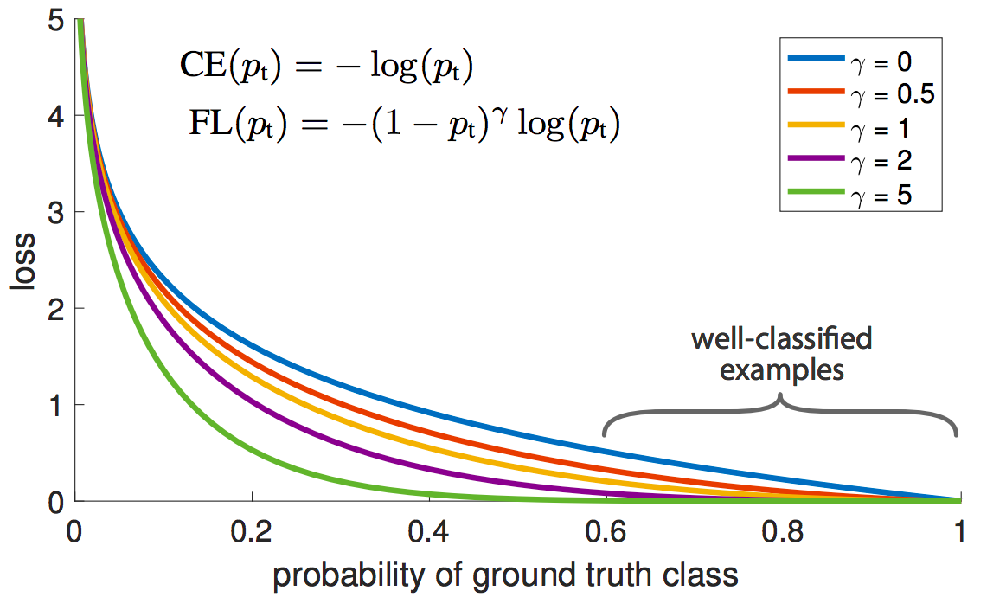
RetinaNet
Combine feature pyramid network with focal loss to reduce the standard cross-entropy loss for well-classified examples
T.-Y. Lin, P. Goyal, R. Girshick, K. He, P. Dollar, Focal loss for dense object detection,
ICCV 2017.
Notes:
From the paper: (1) When an example is misclassified and pt is small, the modulating factor is near 1 and the loss is unaffected. As pt → 1, the factor goes to 0 and the loss for well-classified examples is down-weighted. (2) The focusing parameter γ smoothly adjusts the rate at which easy examples are downweighted. When γ = 0, FL is equivalent to CE, and as γ is increased the effect of the modulating factor is likewise increased (we found γ = 2 to work best in our experiments)

Slide 67
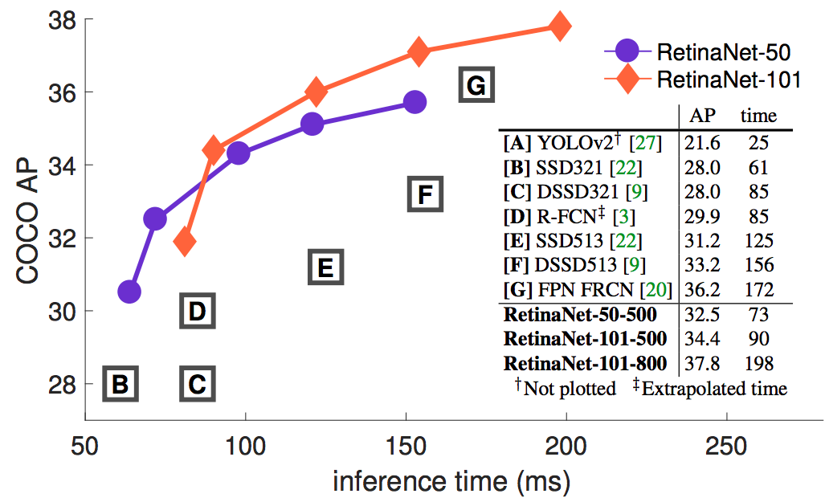
RetinaNet: Results
T.-Y. Lin, P. Goyal, R. Girshick, K. He, P. Dollar, Focal loss for dense object detection,
ICCV 2017.
Notes:
From the paper: Speed (ms) versus accuracy (AP) on COCO test-dev. Enabled by the focal loss, our simple one-stage RetinaNet detector outperforms all previous one-stage and two-stage detectors, including the best reported Faster R-CNN [28] system from [20]. We show variants of RetinaNet with ResNet-50-FPN (blue circles) and ResNet-101-FPN (orange diamonds) at five scales (400-800 pixels). Ignoring the low-accuracy regime (AP)

Slide 68
Summary and Comparison
Part IV

Slide 69
Speed / Accuracy Trade-off
Unified tensorflow architecture
Compare speed, accuracy and memory usage
Speed/Accuracy trade-offs for modern convolutional object detectors
Jonathan Huang, Kevin Murphy et al.
Nov 2016
https://people.eecs.berkeley.edu/~rbg/papers/r-cnn-cvpr.pdf

Slide 70
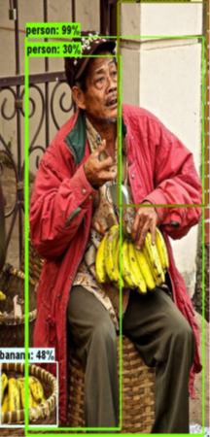
Same Architectures
https://pan.baidu.com/s/1pKIKIIB
Speed
Accuracy
Memory
...
Faster RCNN
Feature Extractor
R-FCN
SSD
Notes:
refer

Slide 71
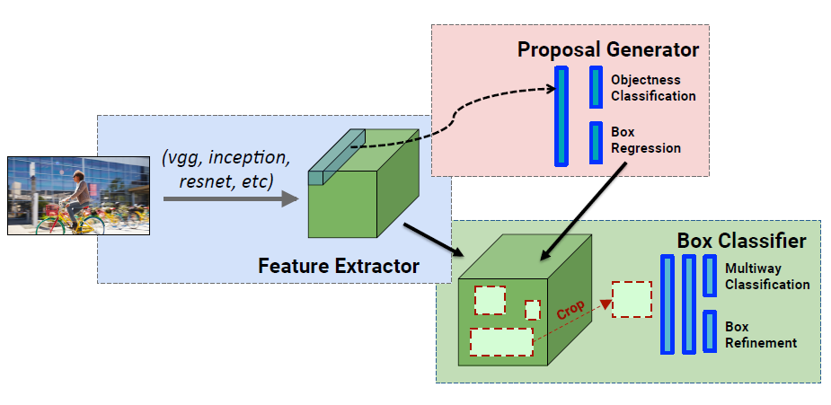
Recap: Faster RCNN
https://pan.baidu.com/s/1pKIKIIB

Slide 72
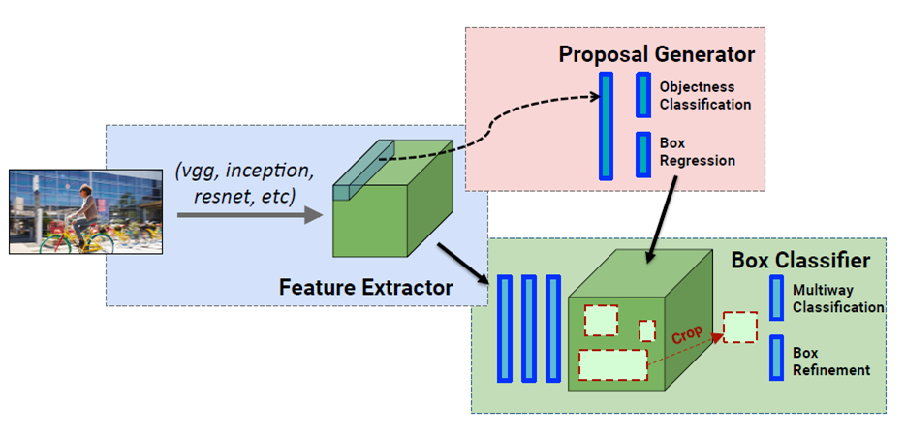
Recap: R-FCN
https://pan.baidu.com/s/1pKIKIIB

Slide 73
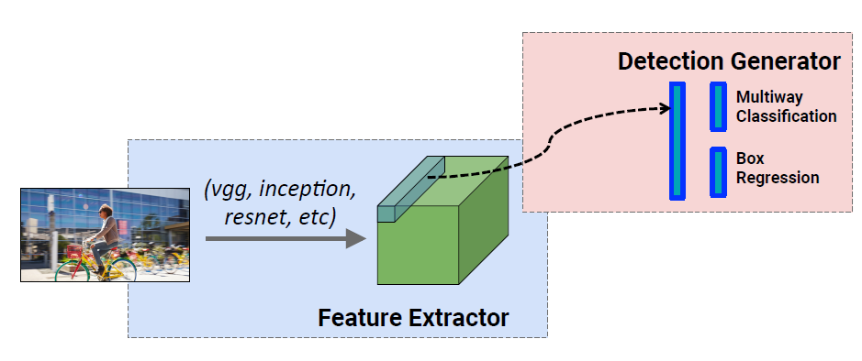
Recap: SSD
https://pan.baidu.com/s/1pKIKIIB

Slide 74
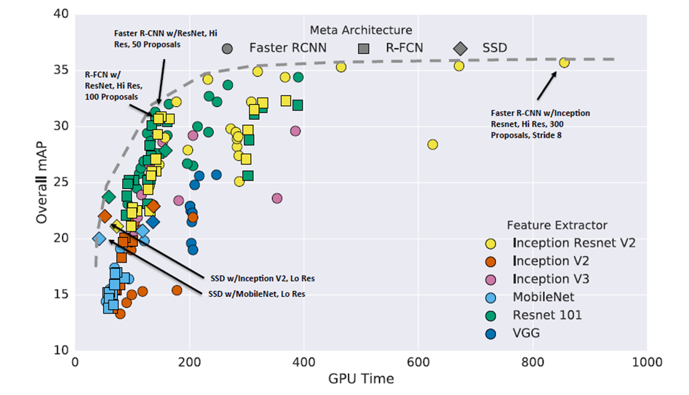
Accuracy VS Speed

Slide 75
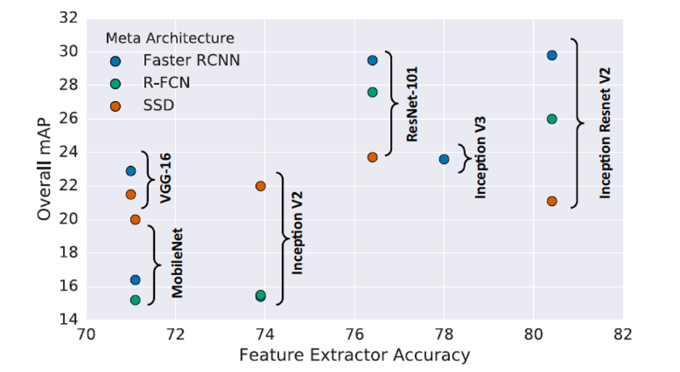
Different Feature Extractor

Slide 76
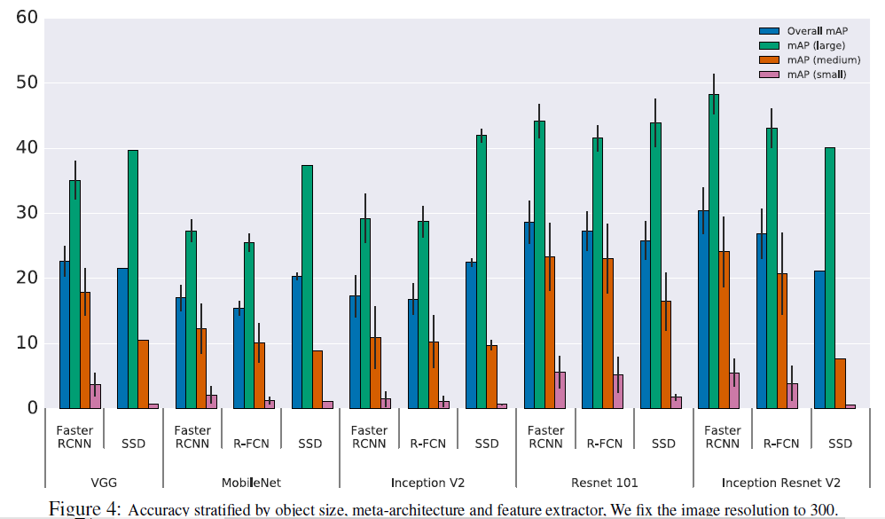
2. Detect Object Size

Slide 77
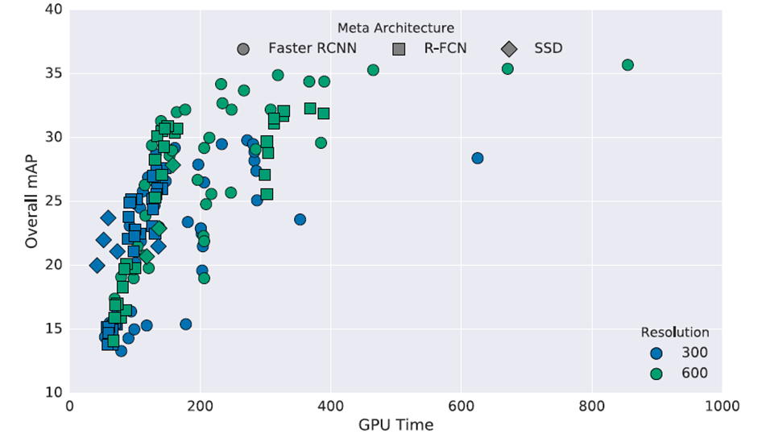
3. Image Resolution

Slide 78
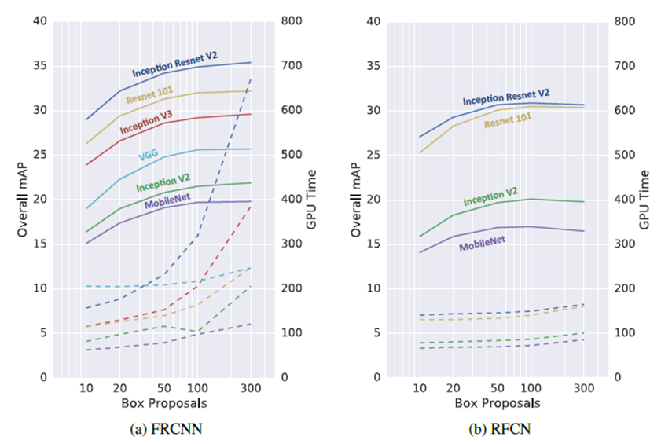
4. Region Proposal Number

Slide 79

5. GPU Time

Slide 80

6. Memory

Slide 81
Summary
Speed First: SSD
Balance Speed and Accuracy: R-FCN
Accuracy First: Faster RCNN (Reduce proposals, it can speed up a lot with some accuracy loss)

Slide 82
Summary: Object detection with CNNs
R-CNN: region proposals + CNN on cropped, resampled regions
Fast R-CNN: region proposals + RoI pooling on top of a conv feature map
Faster R-CNN: RPN + RoI pooling
Next generation of detectors
Direct prediction of BB offsets, class scores on top of conv feature maps
Get better context by combining feature maps at multiple resolutions

Slide 83
Semantic Segmentation, Dense Labeling

Slide 84

Semantic segmentation
From CS543 LAZ

Slide 85

Why Semantic Segmentation ?
Road Scene Understanding
Useful for Self-Driving Car and autonomous drones
From cityscape dataset

Slide 86



Why Semantic Segmentation ?
Medical Image Analysis
From web

Slide 87


Very Challenging Problem

Slide 88


History
Problem: label each pixel by one of C classes
Define an energy function where unaries correspond to local classifier responses and smoothing potentials correspond to contextual terms
Solve a multi-class graph cut problem
From TextonBoost, ECCV 2006

Slide 89

History
CRF energy function is defined on super-pixels:
Unaries are based on nearest neighbor retrieval
Pairwise potentials capture class co-occurrence statistics
J. Tighe and S. Lazebnik, SuperParsing, ECCV 2010

Slide 90
Now, what is happening
How deep neural networks can be used for Semantic Segmentation ?
How to model local and contextual information with Deep Nets ?
Differences and Similarities among methods ?

Slide 91

Zoom-out Features
Feedforward Semantic Segmentation With Zoom-Out Features, CVPR 2015

Slide 92

Hypercolumns Representation
Hypercolumns for object segmentation and fine-grained localization CVPR 2015

Slide 93

Hypercolumn Representation
upsampling
Hypercolumns for object segmentation and fine-grained localization CVPR 2015

Slide 94


Hypercolumn Representation
Hypercolumns for object segmentation and fine-grained localization CVPR 2015

Slide 95

Evaluation
Mean IoU
Per-class evaluation: an intersection of the predicted and true sets
of pixels for a given class, divided by their union (IoU)
 | VOC 2012
Zoom-out | 69.6
Hypercolumn | 62.6

Slide 96




Evaluation
Zoom-out Method on Pascal VOC2012

Slide 97
Hypercolumn and Zoom out
Both uses the multi-scale features from intermediate layers in CNN
Both use upsampling operations for each scale
Any Pixel to Pixel ways ?
Can upsampling be learned ?

Slide 98

FCN for Semantic Segmentation
Fully convolutional Networks for Semantic Segmentation, CVPR 2015

Slide 99

Convnets for Classification
Fully convolutional Networks for Semantic Segmentation, CVPR 2015

Slide 100

Convnets for Segmentation ?
Fully convolutional Networks for Semantic Segmentation, CVPR 2015

Slide 101

From Convnets to FCN
Fully convolutional Networks for Semantic Segmentation, CVPR 2015

Slide 102

Pixel in , Pixel out
Upsampling is backwards strided convolution

Slide 103


How does convolution works ?
Convolution as a matrix operation
From Theano Document Website

Slide 104

Upsampling is backwards strided convolution
Transposed convolution
From Theano Document Website

Slide 105

Framework of FCN

Slide 106


Framework of FCN

Slide 107

More than one upsampling layer
Noh et al, “Learning Deconvolution Network for Semantic Segmentation”, ICCV 2015

Slide 108


FCN is still not good ?
Very coarse feature maps --- FCN-8s is still very coarse

Slide 109


Dilated Convolution
Discrete Convolution Operation:
Dilated Convolution Operation:

Slide 110

Dilated Convolution

Slide 111

Dilated Convolution

Slide 112
Network with Dilated Convolution
Following FCN structure
Using VGG-16 networks with modifications
Called Front End and greatly improve performance

Slide 113


Network with Dilated Convolution
From arunmallya

Slide 114

Network with Dilated Convolution

Slide 115
End of slides
Questions?

